Slide 1
Regression
Regression analysis is one of the most important fields in statistics and machine learning. There are many regression methods available. Linear regression is one of them.

Slide 2
What Is Regression?
Regression searches for relationships among variables. For example, you can observe several employees of some company and try to understand how their salaries depend on their features, such as experience, education level, role, city of employment, and so on.
This is a regression problem where data related to each employee represents one observation. The presumption is that the experience, education, role, and city are the independent features, while the salary depends on them.
Similarly, you can try to establish the mathematical dependence of housing prices on area, number of bedrooms, distance to the city center, and so on.

Slide 3
Generally, in regression analysis, you consider some phenomenon of interest and have a number of observations. Each observation has two or more features. Following the assumption that at least one of the features depends on the others, you try to establish a relation among them.
In other words, you need to find a function that maps some features or variables to others sufficiently well.
The dependent features are called the dependent variables, outputs, or responses. The independent features are called the independent variables, inputs, regressors, or predictors.
Regression problems usually have one continuous and unbounded dependent variable. The inputs, however, can be continuous, discrete, or even categorical data such as gender, nationality, or brand.
It’s a common practice to denote the outputs with 𝑦 and the inputs with 𝑥. If there are two or more independent variables, then they can be represented as the vector 𝐱 = (𝑥₁, …, 𝑥ᵣ), where 𝑟 is the number of inputs.

Slide 4
When Do You Need Regression?
Typically, you need regression to answer whether and how some phenomenon influences the other or how several variables are related. For example, you can use it to determine if and to what extent experience or gender impacts salaries.
Regression is also useful when you want to forecast a response using a new set of predictors. For example, you could try to predict electricity consumption of a household for the next hour given the outdoor temperature, time of day, and number of residents in that household.
Regression is used in many different fields, including economics, computer science, and the social sciences. Its importance rises every day with the availability of large amounts of data and increased awareness of the practical value of data.

Slide 5
Linear Regression
Linear regression is probably one of the most important and widely used regression techniques. It’s among the simplest regression methods. One of its main advantages is the ease of interpreting results.
Problem Formulation
When implementing linear regression of some dependent variable 𝑦 on the set of independent variables
𝐱 = (𝑥₁, …, 𝑥ᵣ), where 𝑟 is the number of predictors,
you assume a linear relationship between 𝑦 and 𝐱: 𝑦 = 𝛽₀ + 𝛽₁𝑥₁ + ⋯ + 𝛽ᵣ𝑥ᵣ + 𝜀.
This equation is the regression equation. 𝛽₀, 𝛽₁, …, 𝛽ᵣ are the regression coefficients, and 𝜀 is the random error.

Slide 6
Linear regression calculates the estimators of the regression coefficients or simply the predicted weights, denoted with 𝑏₀, 𝑏₁, …, 𝑏ᵣ.
These estimators define the estimated regression function 𝑓(𝐱) = 𝑏₀ + 𝑏₁𝑥₁ + ⋯ + 𝑏ᵣ𝑥ᵣ.
This function should capture the dependencies between the inputs and output sufficiently well.
The estimated or predicted response, 𝑓(𝐱ᵢ), for each observation 𝑖 = 1, …, 𝑛, should be as close as possible to the corresponding actual response 𝑦ᵢ.
The differences 𝑦ᵢ - 𝑓(𝐱ᵢ) for all observations 𝑖 = 1, …, 𝑛, are called the residuals.
Regression is about determining the best predicted weights—that is, the weights corresponding to the smallest residuals.
To get the best weights, you usually minimize the sum of squared residuals (SSR) for all observations 𝑖 = 1, …, 𝑛: SSR = Σᵢ(𝑦ᵢ - 𝑓(𝐱ᵢ))².
This approach is called the method of ordinary least squares.

Slide 7
Regression Performance
The variation of actual responses 𝑦ᵢ, 𝑖 = 1, …, 𝑛, occurs partly due to the dependence on the predictors 𝐱ᵢ. However, there’s also an additional inherent variance of the output.
The coefficient of determination, denoted as 𝑅², tells you which amount of variation in 𝑦 can be explained by the dependence on 𝐱, using the particular regression model.
A larger 𝑅² indicates a better fit and means that the model can better explain the variation of the output with different inputs.
The value 𝑅² = 1 corresponds to SSR = 0. That’s the perfect fit, since the values of predicted and actual responses fit completely to each other.

Slide 8
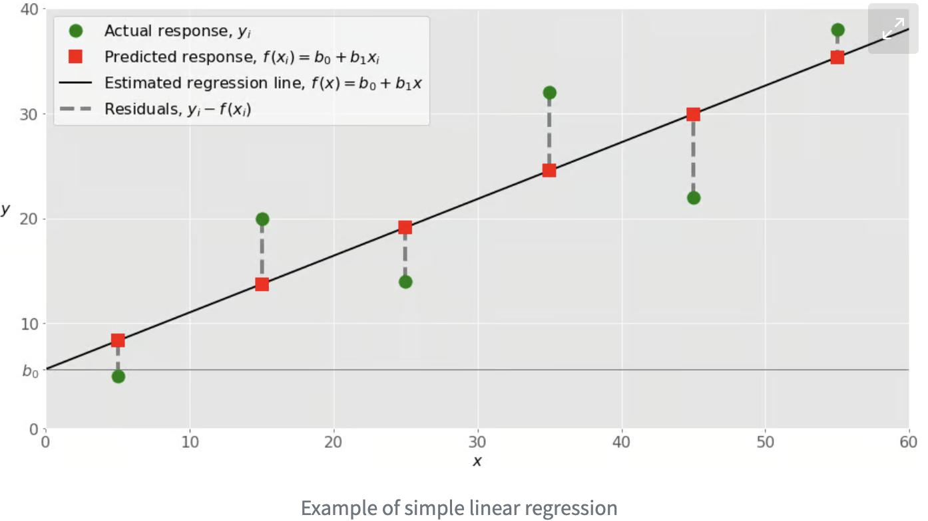
Simple Linear Regression
Simple or single-variate linear regression is the simplest case of linear regression, as it has a single independent variable, 𝐱 = 𝑥.
The following figure illustrates simple linear regression:
When implementing simple linear regression, you typically start with a given set of input-output (𝑥-𝑦) pairs. These pairs are your observations, shown as green circles in the figure. For example, the leftmost observation has the input 𝑥 = 5 and the actual output, or response, 𝑦 = 5. The next one has 𝑥 = 15 and 𝑦 = 20, and so on.

Slide 9
The estimated regression function, represented by the black line, has the equation 𝑓(𝑥) = 𝑏₀ + 𝑏₁𝑥. Your goal is to calculate the optimal values of the predicted weights 𝑏₀ and 𝑏₁ that minimize SSR and determine the estimated regression function.
The value of 𝑏₀, also called the intercept, shows the point where the estimated regression line crosses the 𝑦 axis. It’s the value of the estimated response 𝑓(𝑥) for 𝑥 = 0. The value of 𝑏₁ determines the slope of the estimated regression line.
The predicted responses, shown as red squares, are the points on the regression line that correspond to the input values. For example, for the input 𝑥 = 5, the predicted response is 𝑓(5) = 8.33, which the leftmost red square represents.
The vertical dashed grey lines represent the residuals, which can be calculated as 𝑦ᵢ - 𝑓(𝐱ᵢ) = 𝑦ᵢ - 𝑏₀ - 𝑏₁𝑥ᵢ for 𝑖 = 1, …, 𝑛. They’re the distances between the green circles and red squares.
When you implement linear regression, you’re actually trying to minimize these distances and make the red squares as close to the predefined green circles as possible.

Slide 10
Simple Linear Regression With scikit-learn
You’ll start with the simplest case, which is simple linear regression. There are five basic steps when you’re implementing linear regression:
Import the packages and classes that you need.
Provide data to work with, and eventually do appropriate transformations.
Create a regression model and fit it with existing data.
Check the results of model fitting to know whether the model is satisfactory.
Apply the model for predictions.

